Slide 1
Chapter 03: Block Ciphers and the DES
Freshman Seminar
2022.01.11
Sumin Sohn

Slide 2
Contents
3.1 Traditional Block Cipher Structure
3.3 Avalanche Effect
3.5 Block Cipher Design Principles

Slide 3
3.1 Traditional Block Cipher Structure

Slide 4
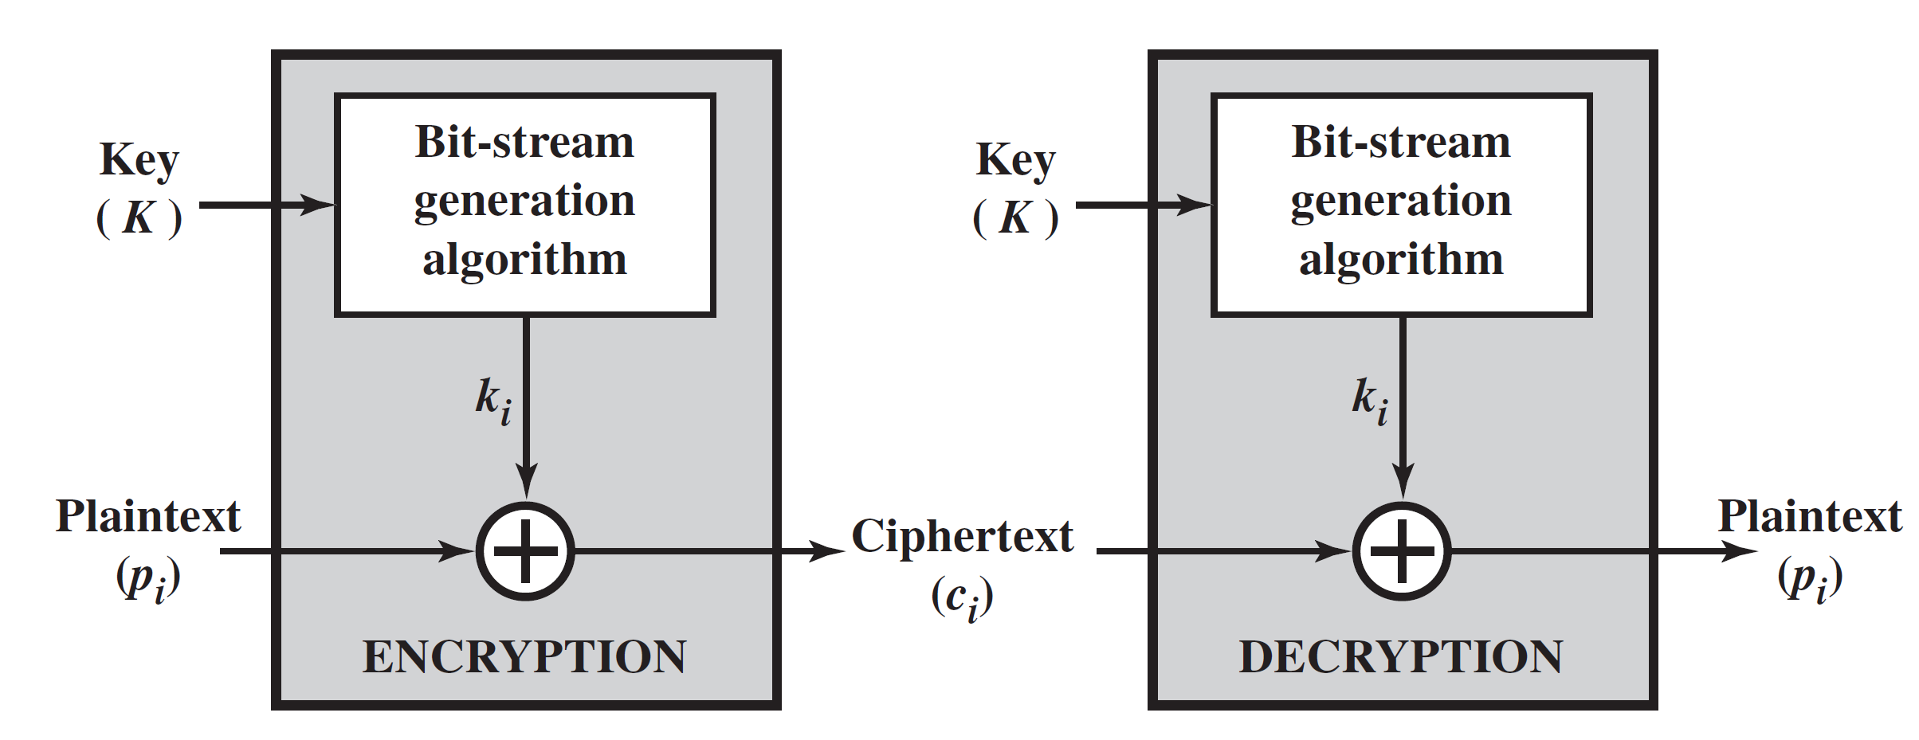
Stream Ciphers
Encrypts a digital data stream one bit or one byte at a time
Keystream is as long as the plaintext bit stream
For practical reasons, the bit-stream generator is used
Should be algorithmic, key-controlled, strong
Need to share the generating key

Slide 5
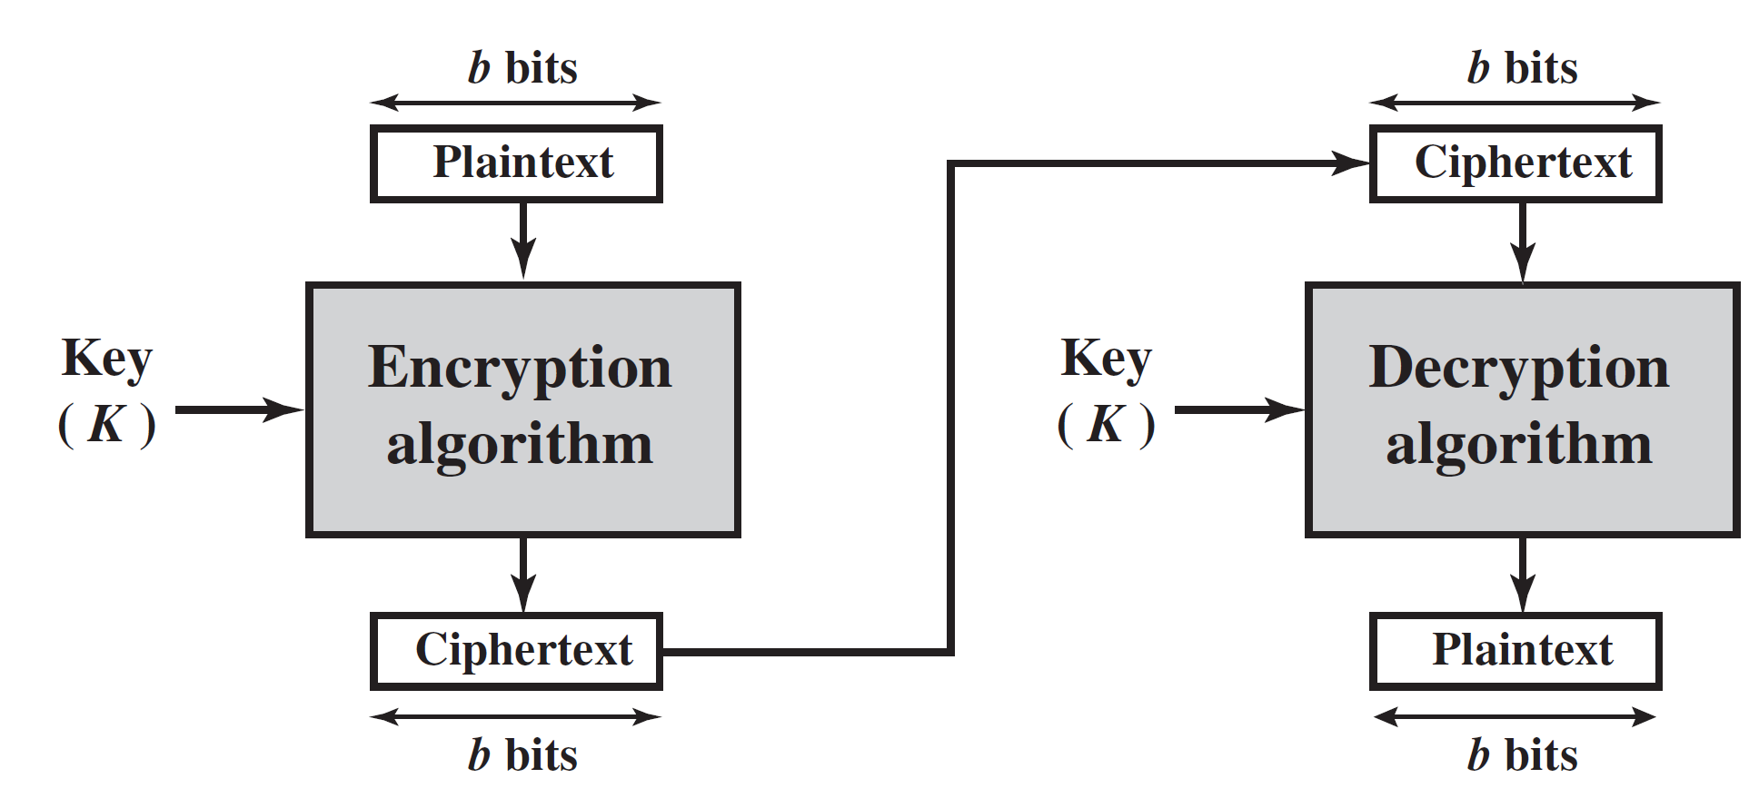
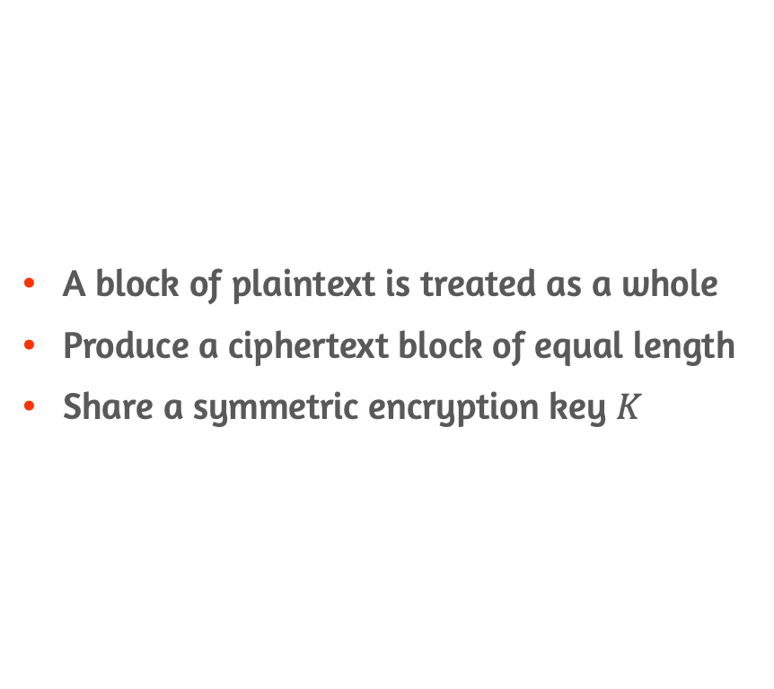
Block Ciphers
A block of plaintext is treated as a whole
Produce a ciphertext block of equal length
Share a symmetric encryption key $K$

Slide 6
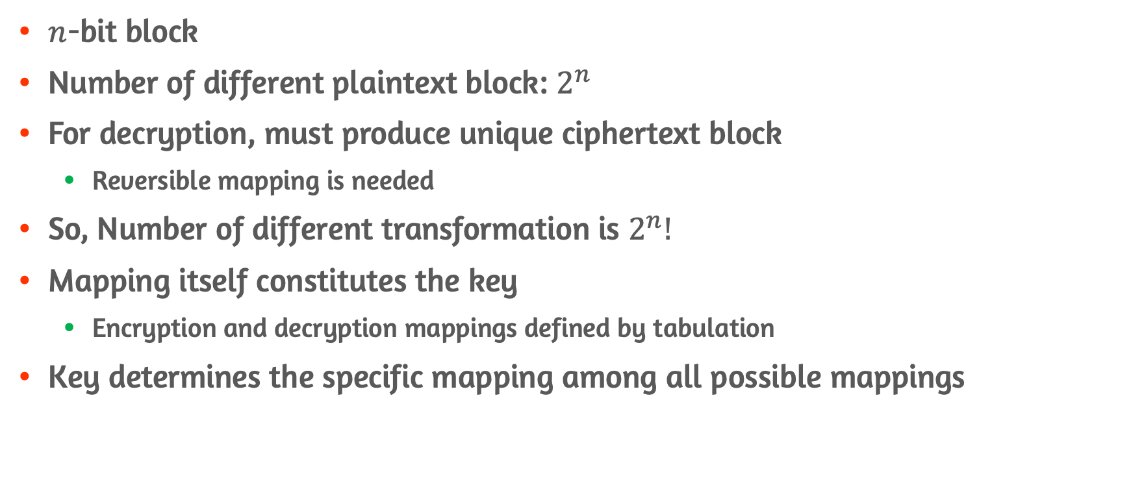
Ideal Block Cipher
$n$-bit block
Number of different plaintext block: $2^{n}$
For decryption, must produce unique ciphertext block
Reversible mapping is needed
So, Number of different transformation is $2^{n}!$
Mapping itself constitutes the key
Encryption and decryption mappings defined by tabulation
Key determines the specific mapping among all possible mappings

Slide 7
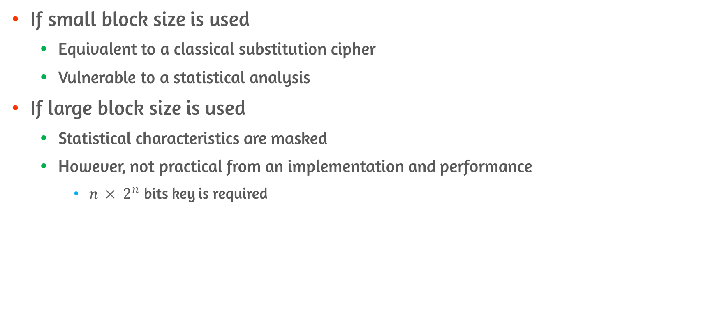
Problems of Ideal Block Cipher
If small block size is used
Equivalent to a classical substitution cipher
Vulnerable to a statistical analysis
If large block size is used
Statistical characteristics are masked
However, not practical from an implementation and performance
$n × 2^{n}$ bits key is required

Slide 8
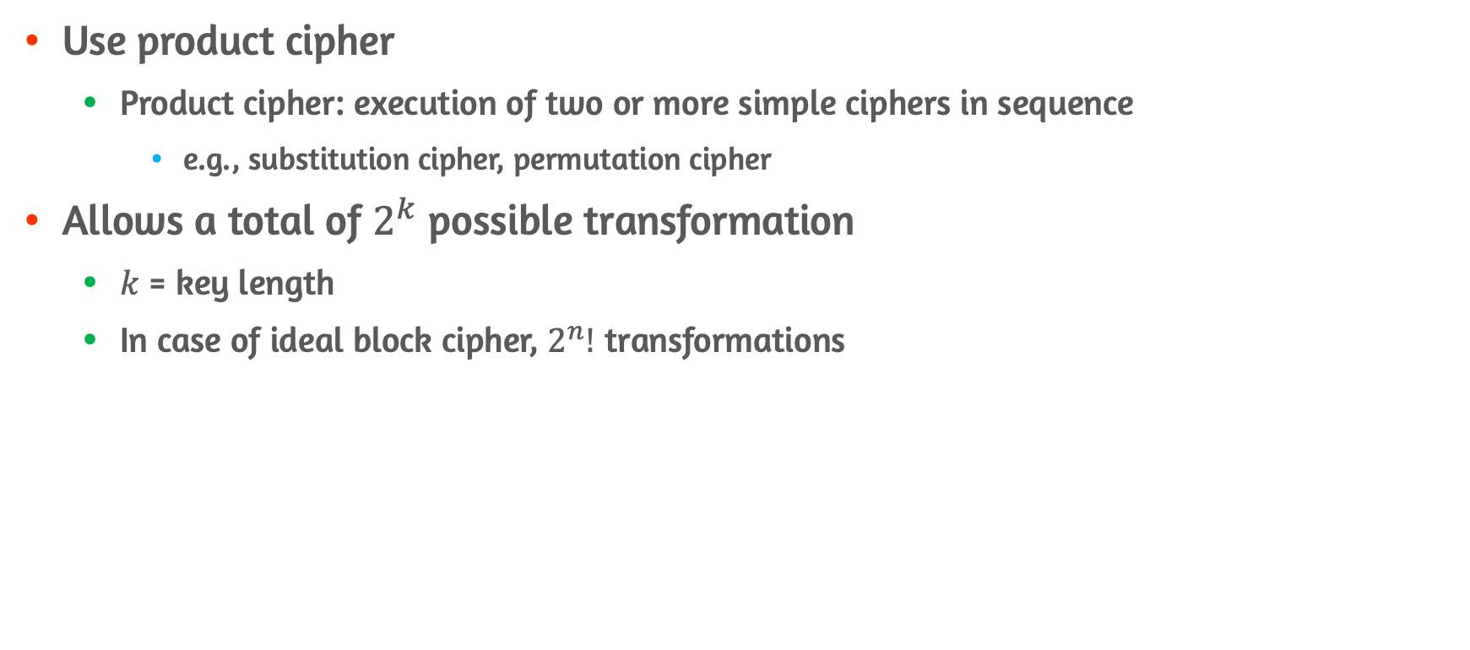
Overview of Feistel Cipher
Use product cipher
Product cipher: execution of two or more simple ciphers in sequence
e.g., substitution cipher, permutation cipher
Allows a total of $2^{k}$ possible transformation
$k$ = key length
In case of ideal block cipher, $2^{n}!$ transformations

Slide 9
Substitution and Permutation
Substitution
Each plaintext element is uniquely replaced by a corresponding ciphertext
Permutation
Sequence of plaintext is replaced by a permutation of that sequence

Slide 10
Diffusion and Confusion
Diffusion
Make the complex statistical relationship between the plaintext and ciphertext
Have each plaintext digit affect the value of many ciphertext digits
Letter frequencies in the ciphertext will be equal
Achieved by repeatedly performing permutation
Confusion
Make complex statistical relationship between ciphertext and the value of the encryption key
Thwart attempts to discover the key
Achieved by the use of a complex substitution algorithm

Slide 11
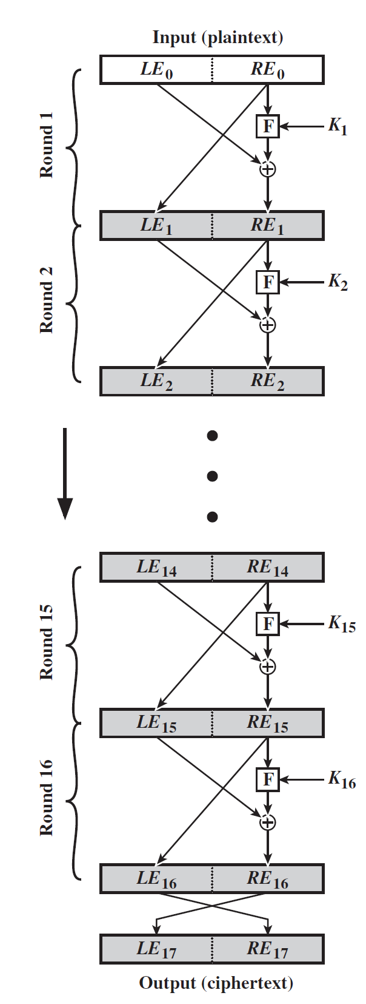
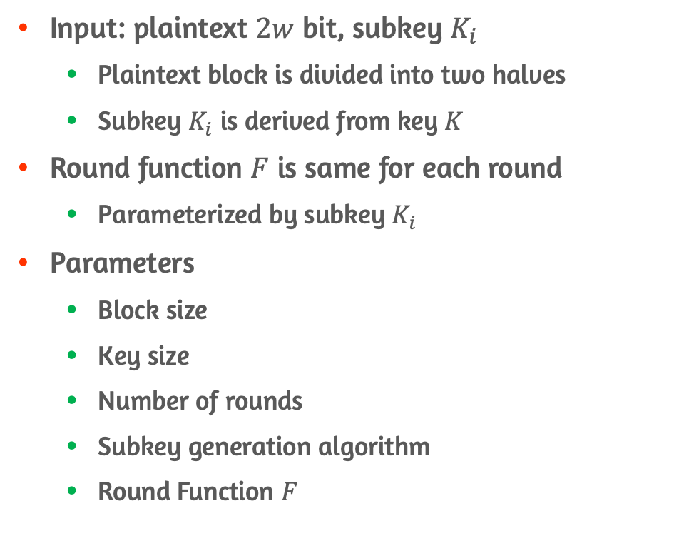
Structure of Feistel Cipher
Input: plaintext $2w$ bit, subkey $K_{i}$
Plaintext block is divided into two halves
Subkey $K_{i}$ is derived from key $K$
Round function $F$ is same for each round
Parameterized by subkey $K_{i}$
Parameters
Block size
Key size
Number of rounds
Subkey generation algorithm
Round Function $F$

Slide 12
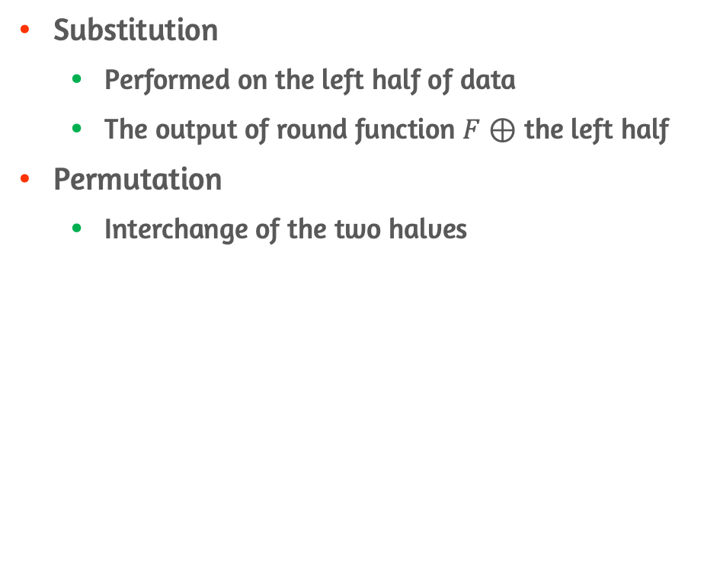
Logic of Feistel Cipher
Substitution
Performed on the left half of data
The output of round function $F$ $⊕$ the left half
Permutation
Interchange of the two halves

Slide 13
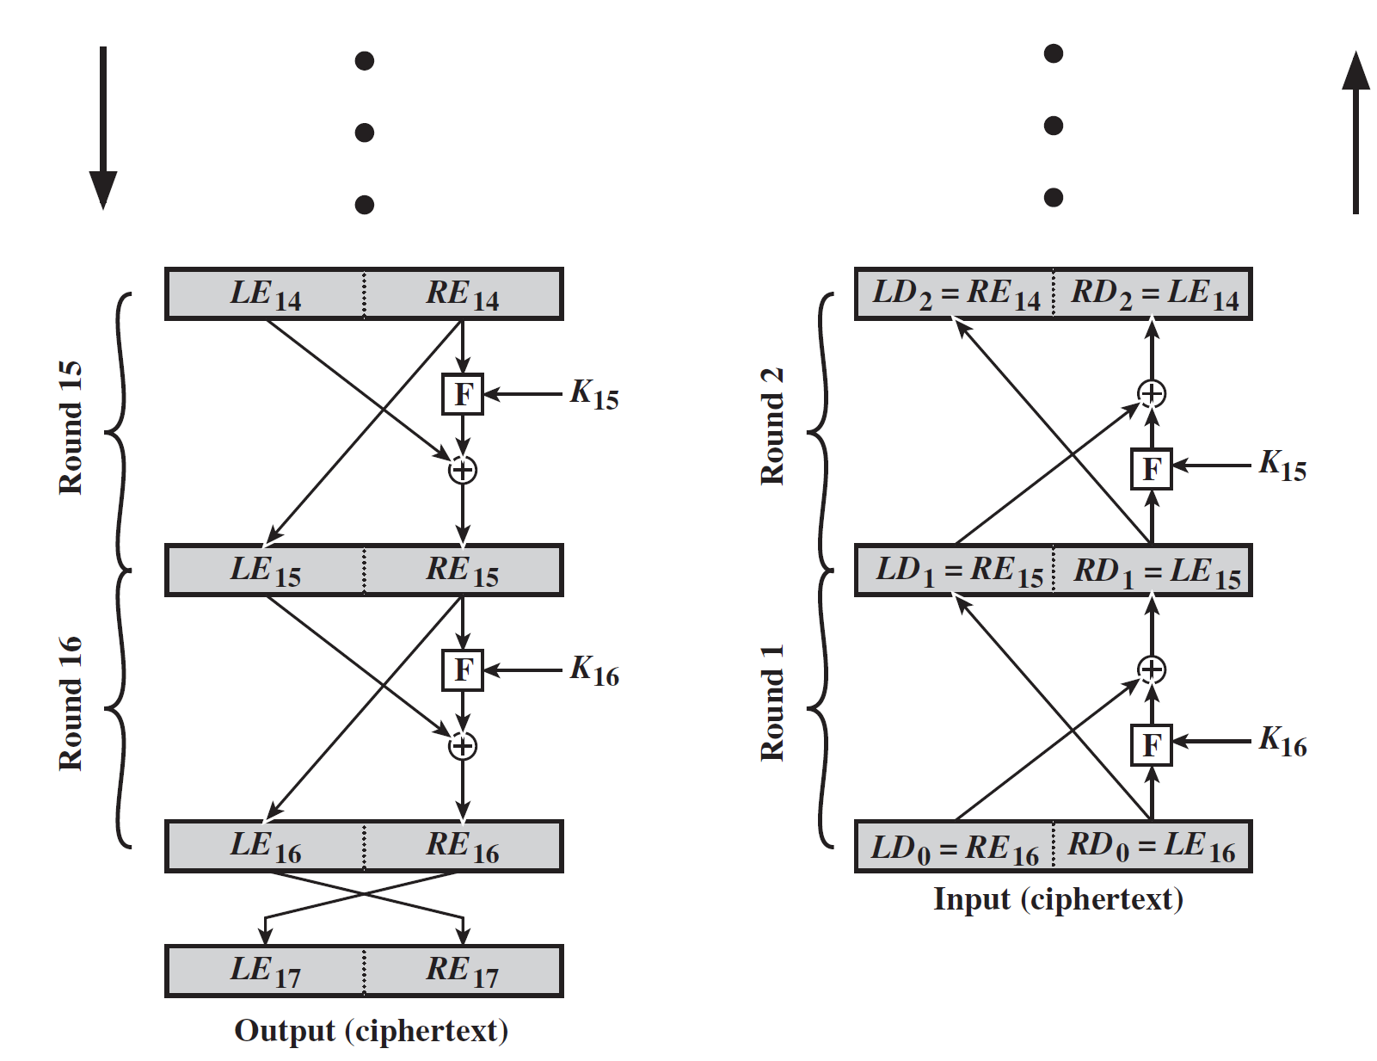
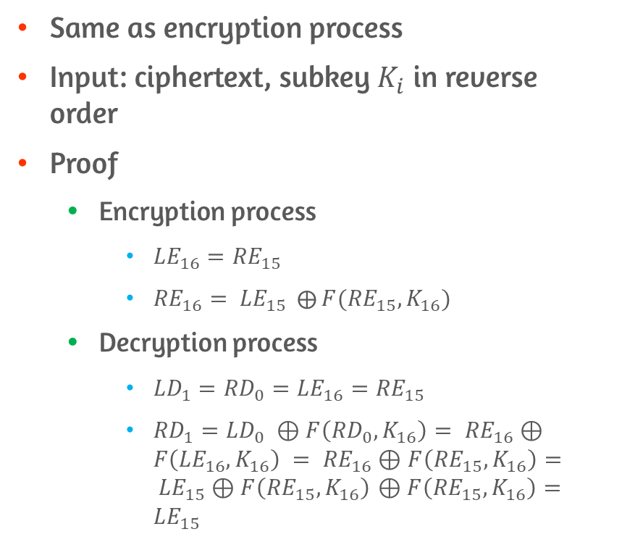
Feistel Decryption Algorithm
Same as encryption process
Input: ciphertext, subkey $K_{i}$ in reverse order
Proof
Encryption process
${LE}_{16}={RE}_{15}$
${RE}_{16}= {LE}_{15} ⨁{F({RE}_{15}, K_{16})}$
Decryption process
${LD}_{1}={RD}_{0}={LE}_{16}={RE}_{15}$
${RD}_{1}={LD}_{0 }$ $⊕F\left({RD}_{0},K_{16}\right)= {RE}_{16}⊕F\left({LE}_{16},K_{16}\right) = {RE}_{16}⊕F\left({RE}_{15},K_{16}\right)= {LE}_{15}⊕F\left({RE}_{15},K_{16}\right)$ $⊕F\left({RE}_{15},K_{16}\right)={LE}_{15}$

Slide 14
3.3 Avalanche Effect

Slide 15
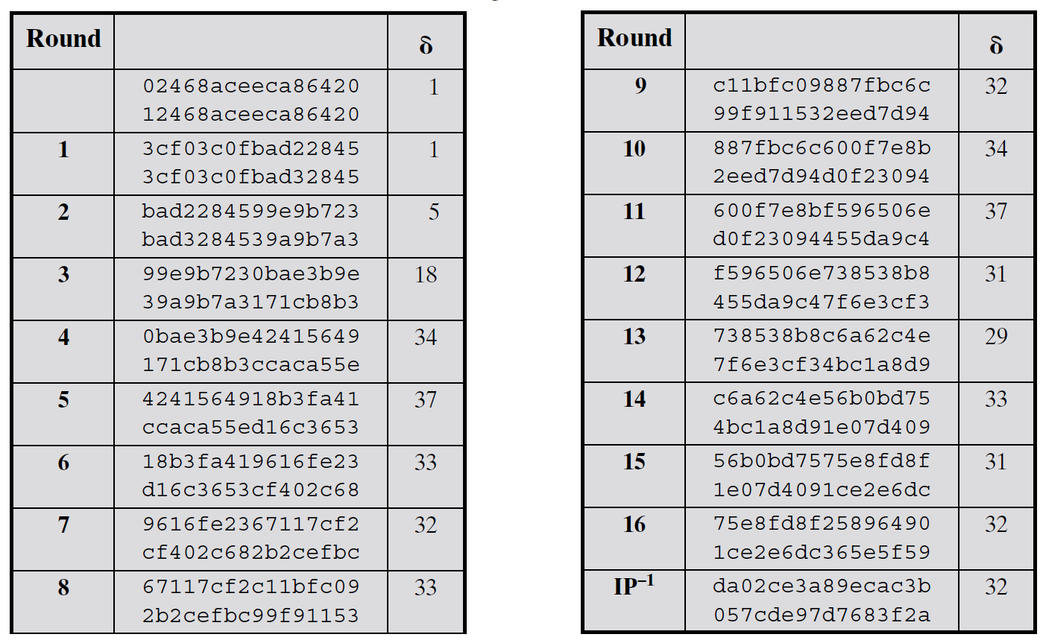
Avalanche Effect
Small change in the plaintext or the key should produce a significant change in the ciphertext

Slide 16
3.5 Block Cipher Design Principles

Slide 17
Block Cipher Design #1
Number of Rounds
The greater the number of rounds, the more difficult to perform cryptanalysis
Should be known cryptanalytic efforts > simple brute-force attack
Key scheduling
Maximize the difficulty of deducing individual subkeys and working back to main key

Slide 18
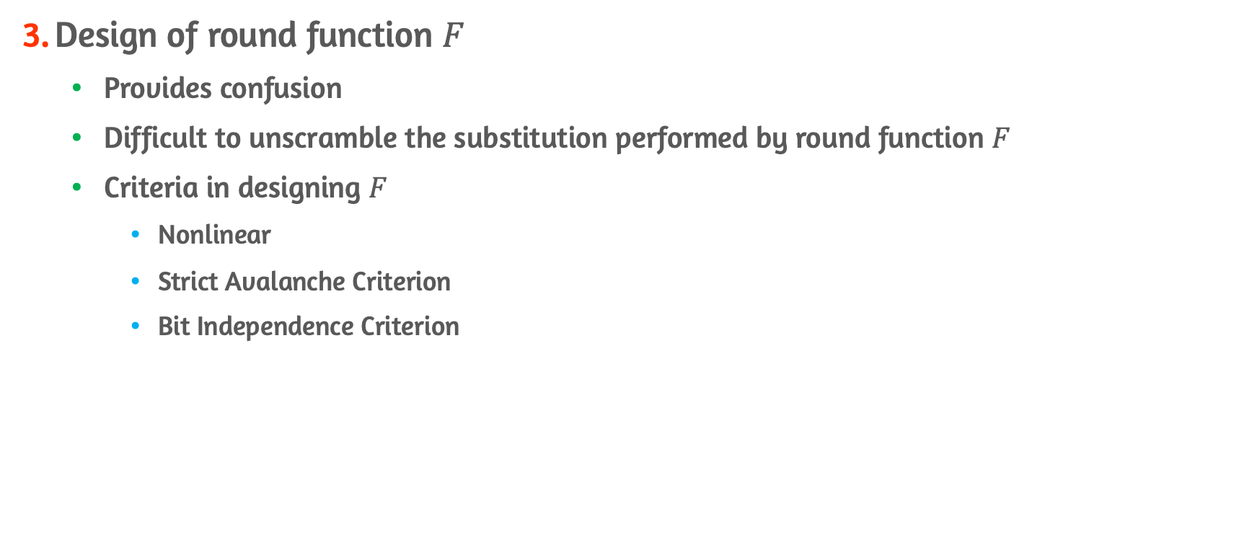
Block Cipher Design #2
Design of round function $F$
Provides confusion
Difficult to unscramble the substitution performed by round function $F$
Criteria in designing $F$
Nonlinear
Strict Avalanche Criterion
Bit Independence Criterion

Slide 19
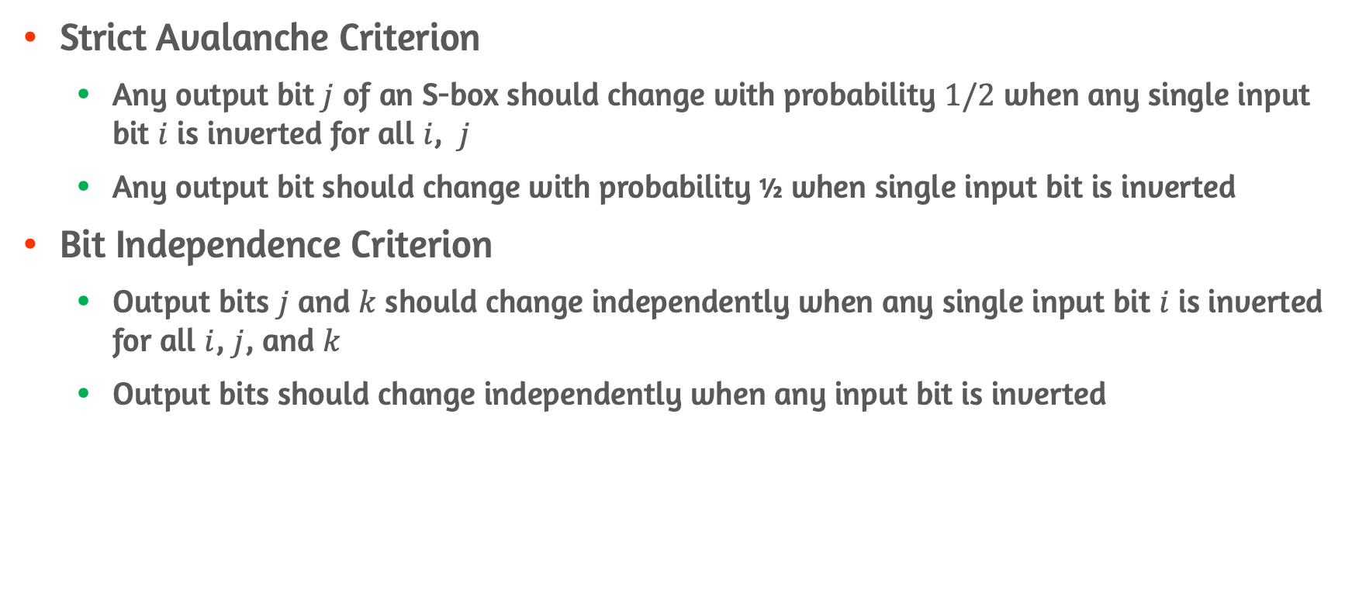

Criterion in designing $F$
Strict Avalanche Criterion
Any output bit $j$ of an S-box should change with probability $1/2$ when any single input bit $i$ is inverted for all $i$, $j$
Any output bit should change with probability ½ when single input bit is inverted
Bit Independence Criterion
Output bits $j$ and $k$ should change independently when any single input bit $i$ is inverted for all $i$, $j$, and $k$
Output bits should change independently when any input bit is inverted

Slide 20
Conclusion
Traditional block cipher structure
Stream cipher vs. Block cipher
Ideal block cipher and Feistel cipher
Diffusion and confusion
Avalanche Effect
Block Cipher Design Principles
Number of rounds, design of round function, key scheduling

